Slide 1
Student name: Phillip C. Katema
Registration number: 18323351062
Guide name: Mrs Sunanthini

Slide 2
EMPLOYEE HEALTH MANAGEMENT SYSTEM
PROJECT TITLE

Slide 3
DOMAIN NAME
DATABASE

Slide 4
ABSTRACT
Organizations currently use a manual system for management and maintenance of their employee medical information. The current system requires numerous paper forms, with data stored throughout the organizational structure. A significant part of the work of the organizations Medical Personnel involves the acquisition, management and timely retrieval of great volumes of the medical information. This information typically involves medical history, hospital records and payment records. All of this information must be managed in an efficient and cost wise manner so that organizational resources may be effectively utilized. The new EMPLOYEE HEALTH MANAGEMENT SYSTEM will automate the management of the employee medical information, making it more efficient and error free. It aims at standardizing and consolidating data, thereby ensuring integrity and reducing inconsistencies.

Slide 5
HARDWARE & SOFTWARE REQUIREMENTS
The development of this health management system will require a combination set of software and hardware.
The software composition for developing this system include:
- Platform : Windows 10 Operating System
- Application Database : Microsoft Access
- Application Interface Development : Visual Basic 2012
The hardware composition for developing this management system include:
Processor : Duo Core processor with or above 2.0 GHz
Hard-disk : 40 GB or above
RAM: 4GB or above

Slide 6
EXISTING SYSTEM
The existing employee health management system is not standardized and efficient. Information is often written on paper forms or entered into a Microsoft Excel file.
Often, information on forms is incomplete, or does not follow a uniform standard. Forms are often lost in transit between departments and multiple copies of the same information exist in the organization which leads to inconsistences in the information.
The operation of the existing system has the following limitations:
- lack of security for the data
- time consuming
- needs a lot of paper work
Duplication of data
Inconsistent data

Slide 7
PROPOSED SYSTEM
To overcome the limitations and make the work more efficient, the system needs to have a Central Database. The aim of this proposed system is to develop a database that can solve the limitations of the current system.
- The proposed system will aim to provide security for the data
- The proposed system will ensure data accuracy as limitations of entry will be put in place
- The proposed system will aim to minimize manual data entry

Slide 8
Modules
A software system is always divided into several sub systems that makes it easier for the development and testing.
The different modules appended in this proposed banking system are:
- Login Module : this module gives authentication to users of the system
- Search Employees Module: this module allows the user to search for employees registered in the system
- Employee registration Module : this module gives access to adding new Employees into the new system
- Records Entry Module: this module will allow the user to add Employees health records into the database.
- Monitoring Tools Module: this module will allow the user to view the employees registered in the system and their hospital records and access other reporting features.

Slide 9
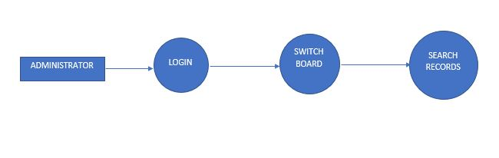
Search Employees module DFD

Slide 10
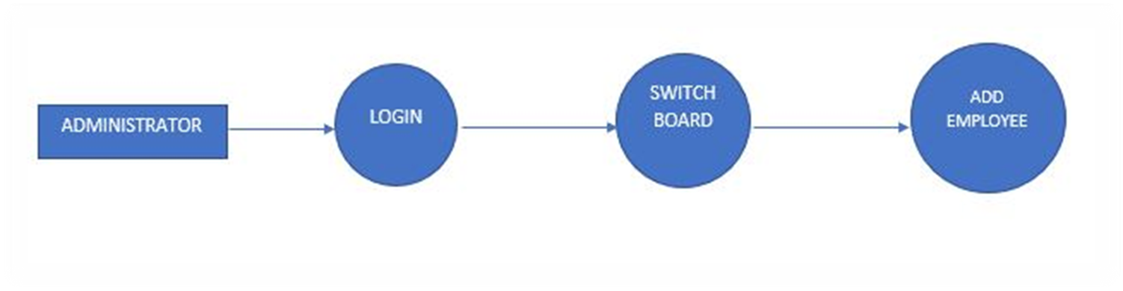
Employee Registration module DFD

Slide 11
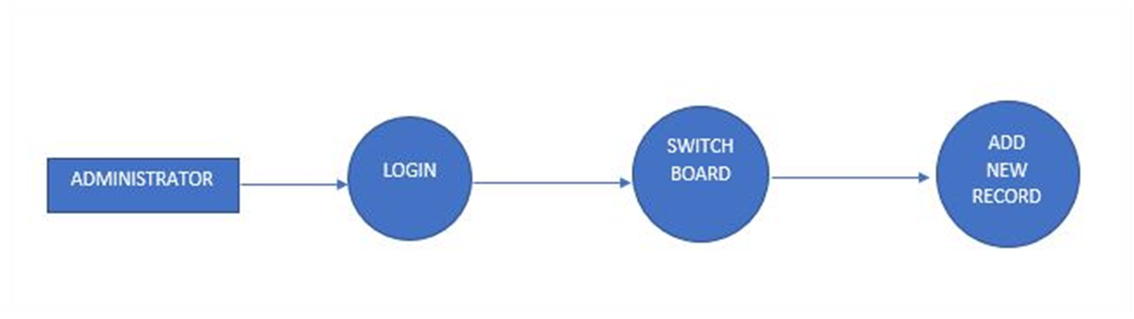
Records entry module DFD

Slide 12
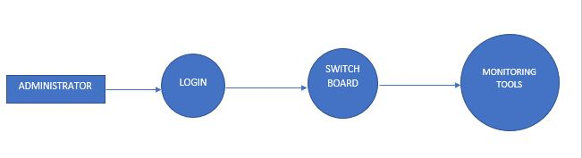
Monitoring tools module DFD

Slide 13


Slide 14
END

